Slide 1
Housing Price Prediction
By Shaun Lin

Slide 2
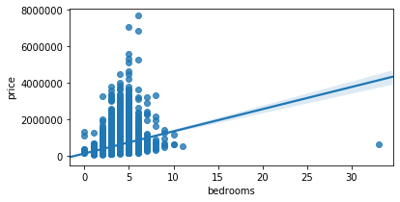
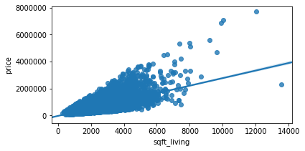
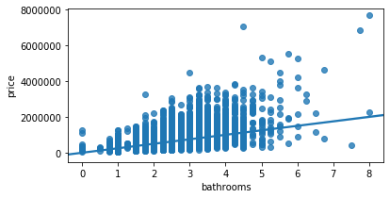
Trying to see the correlation between each features with housing price

Slide 3
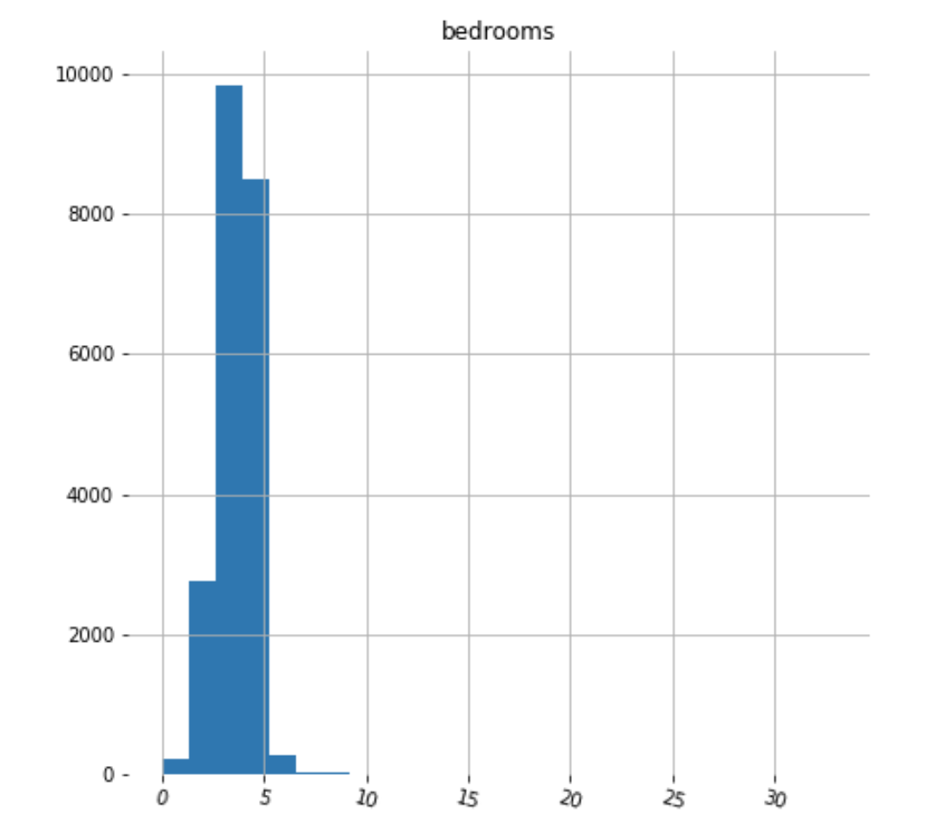
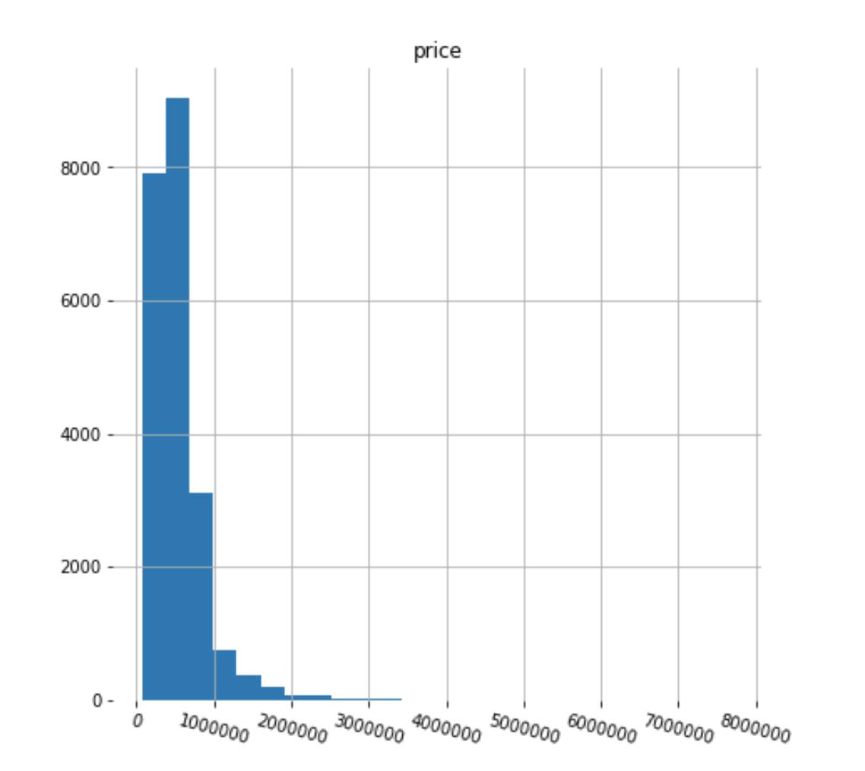
Histograms showing the distribution of the bedrooms and price

Slide 4
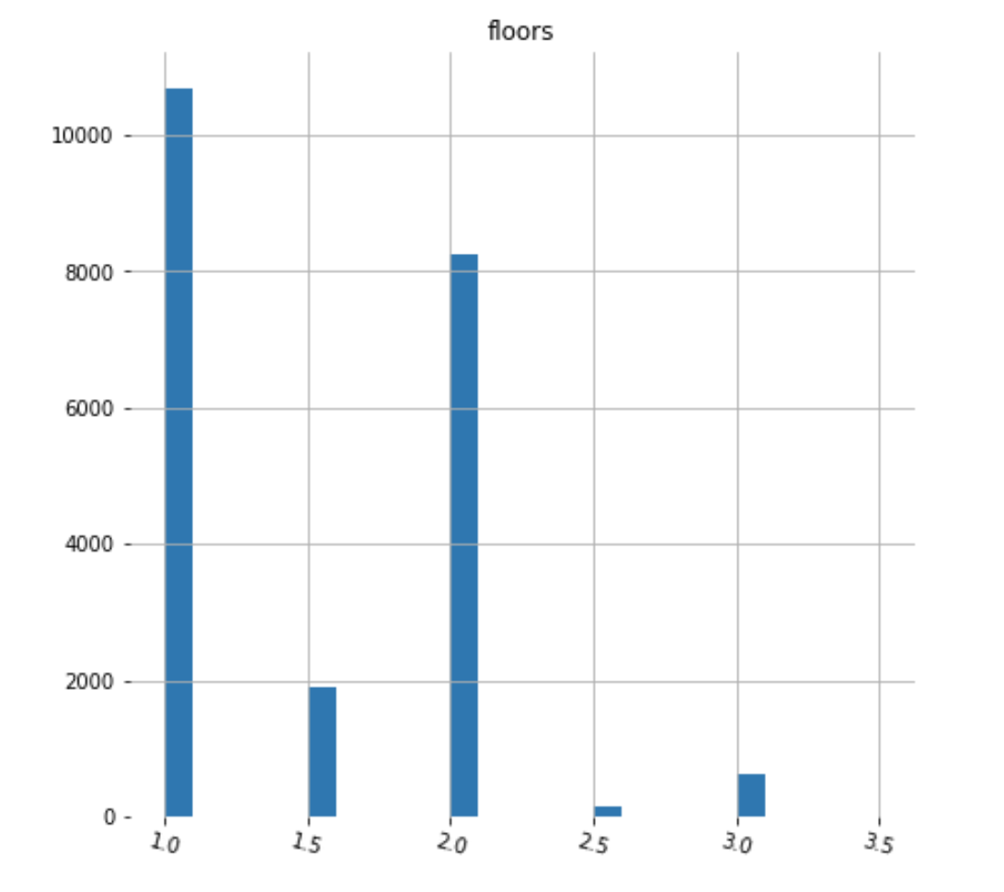
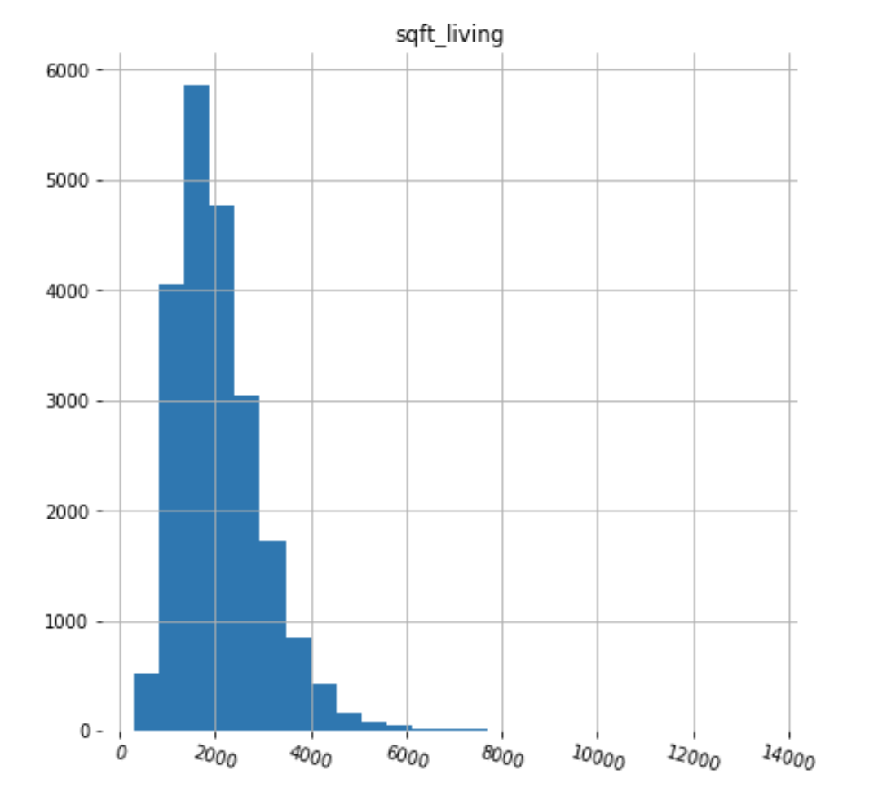
Histograms showing the distribution of the floors and sqft_living

Slide 5
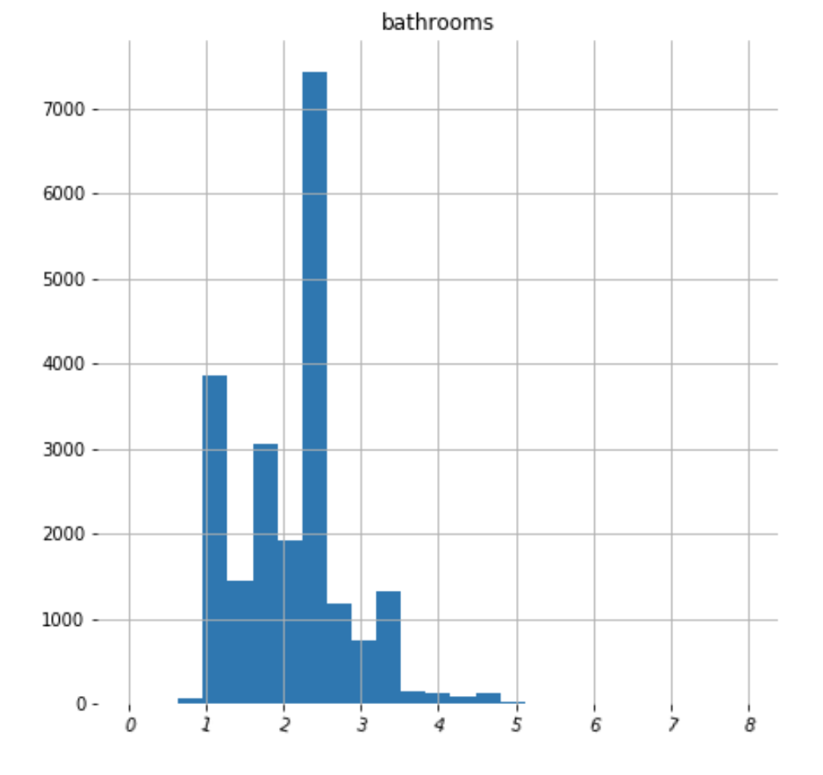
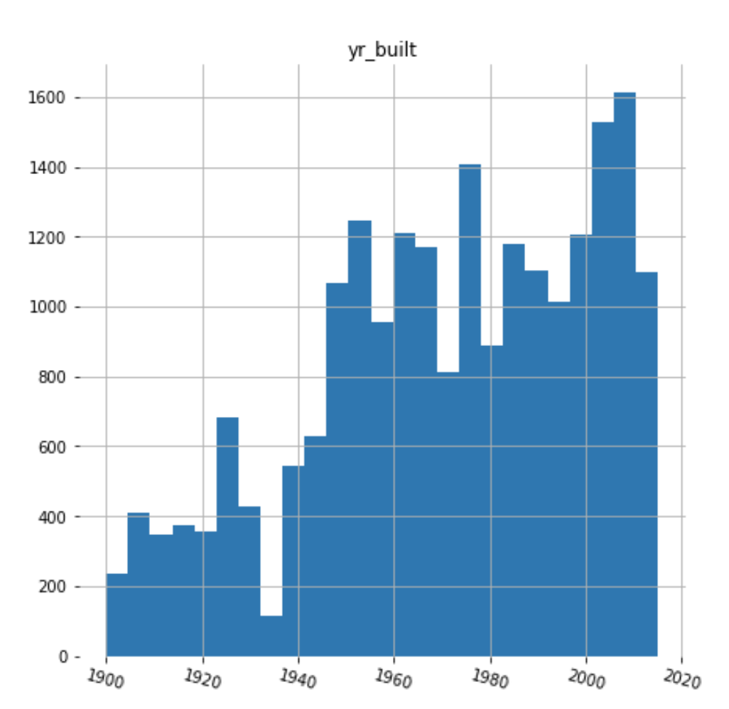
Histograms showing the distribution of the bathrooms and yr_built

Slide 6
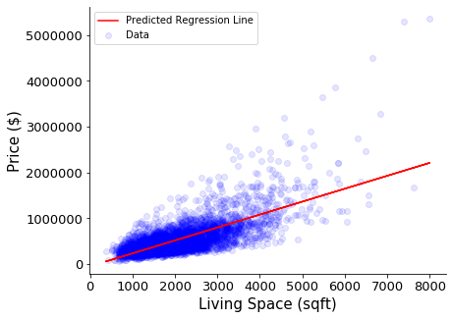
Simple Linear Regression model: using living space (sqft) to predict the house price

Slide 7
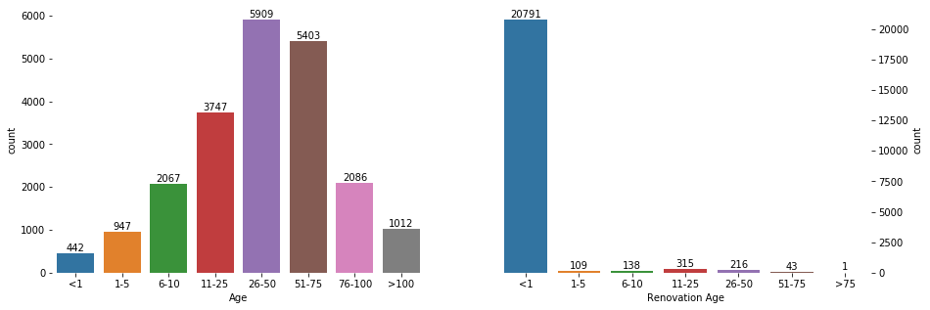

Slide 8
Model | Details | Root Mean Squared Error | R – squared
Linear Regression | Only living space | 25489 | 0.496
Multiple regression | Selected features | 248514 | 0.5188
Multiple regression 2 | All features | 193693 | 0.7077
Multiple regression 3 | All features with additional binned columns | 191879 | 0.7131

